Slide 1
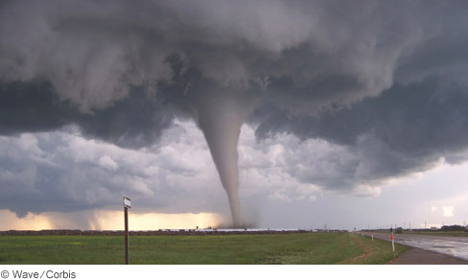
Chapter 11
Fluid Statics
Fluids are materials that can flow: gases and liquids.
Air is the most common gas, and moves from place to place as wind.
Water is the most familiar liquid.
Topics:
Density
Pressure
Pressure Gauges
Pascal’s principle
Archimedes’ principle
Tornado, air is moving very rapidly, moving air has a lower pressure, hence destructive…

Slide 2
Density
The density or mass density, ρ is the mass m of a substance divided by its volume V:
SI Unit of Mass Density: kg/m³
Density is a scalar.

Slide 3
Densities of common substances
Substance | Mass Density ρ (kg/m³)
Liquids Blood (whole, 37⁰C) | 1060
Ethyl alcohol | 806
Mercury | 13 600
Oil (hydraulic) | 800
Water (4⁰C) | 1000
Gases
Air | 1.29
Carbon dioxide | 1.98
Helium | 0.179
Hydrogen | 0.0899
Nitrogen | 1.25
Oxygen | 1.43
Substance | Mass Density ρ (kg/m³)
Solids
Aluminum | 2700
Brass | 8470
Concrete | 2200
Copper | 8890
Diamond | 3520
Gold | 19 300
Ice (0⁰C) | 917
Iron (steel) | 7860
Lead | 11 300
Quartz | 2660
Silver | 10 500
Wood (yellow pine) | 550

Slide 4
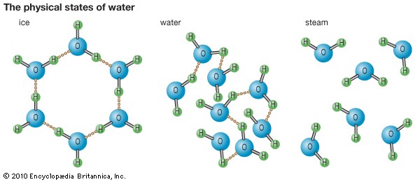
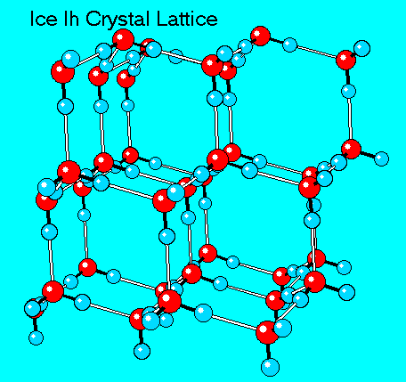
Why Ice Floats on Water?
Ice is less dense than water, hence it floats in water. (Video)
Ice has a hexagonal structure, with each molecule bonding to four others, hence less dense than liquid water.
When water freezes, it needs more empty space, hence it expands, which is an unusual property (pros: living things under frozen lakes & cons: pipe bursting during winter).

Slide 5
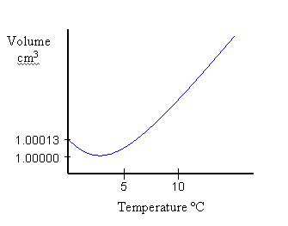
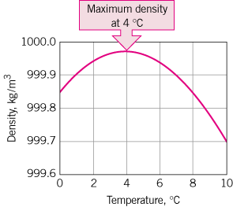
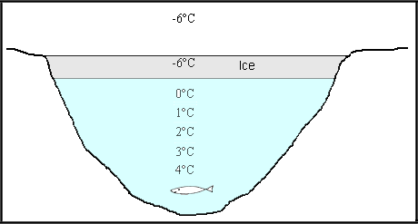

Unusual Expansion of Water
Most substances contract upon cooling. But, water expands while cooling from 4 ⁰C until it freezes.

Slide 6
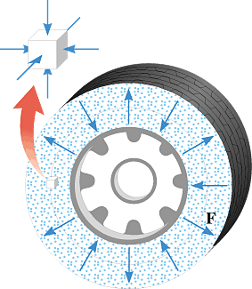
Pressure
The pressure P exerted by a fluid is defined as the magnitude F of the force acting perpendicular to a surface divided by the area A over which the force acts:
The SI unit for pressure: newton/meter² = (N/m²) = pascal (Pa).
Pressure is a scalar.

Slide 7
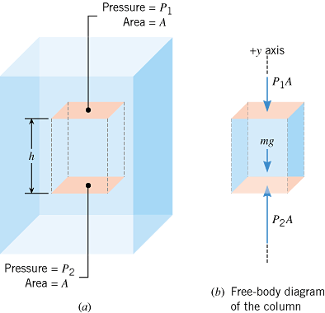


Pressure and Depth in a Static Fluid
m = ρAh
P₂A = P₁A + ρAhg

Slide 8
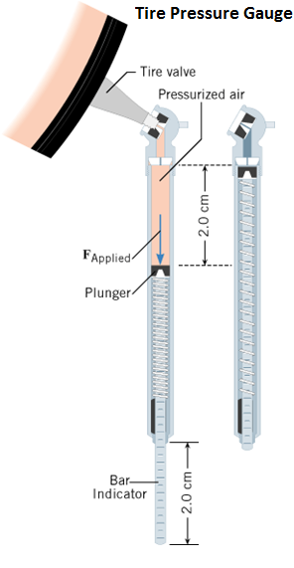
Pressure Gauges
Pressure gauges are used to measure pressures.

Slide 9
Gauge Pressure
Gauge pressure is the pressure measured by a pressure gauge.
It is the difference between the absolute pressure and atmospheric pressure.
Gauge pressure =
  Absolute pressure - atmospheric pressure

Slide 10
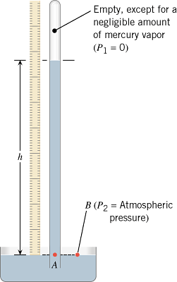
Mercury Barometer
At sea level,
Height of mercury = h = 76 cm.
Atmospheric pressure = 76 cm of Hg.
(76 cm = 760 mm = 29.9 inch)

Slide 11
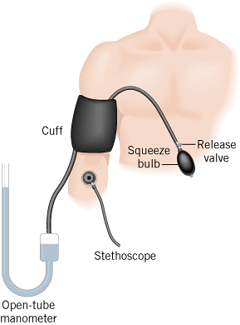
Blood pressure is measured with a sphygmomanometer.
Pressure at the peak of the beating cycle- Systolic.
Pressure at the low point of the beating cycle- Diastolic.
For a young, healthy heart:
Systolic pressure = 120 mm of Hg
Diastolic pressure = 80 mm of Hg

Slide 12
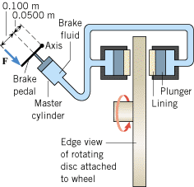
11.5 Pascal's Principle
Any change in the pressure applied to a completely enclosed fluid is transmitted undiminished to all parts of the fluid and the enclosing walls.

Slide 13
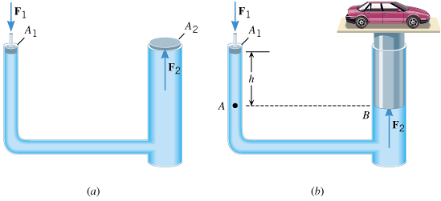

Hydraulic Car Lift
Pascal’s principle says:
$$P_{2}=P_{1}$$

Slide 14

11.7 Archimedes' Principle
Any fluid applies a buoyant force to an object that is partially or completely immersed in it; the magnitude of the buoyant force equals the weight of the fluid that the object displaces:

Slide 15
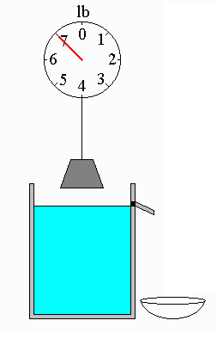
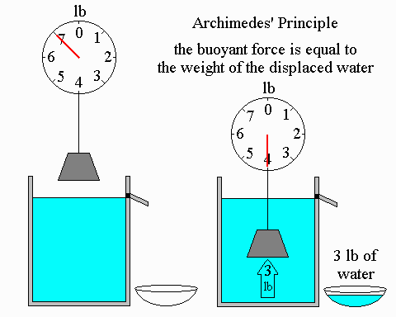
Demonstrating Archimedes’ Principle

Slide 16
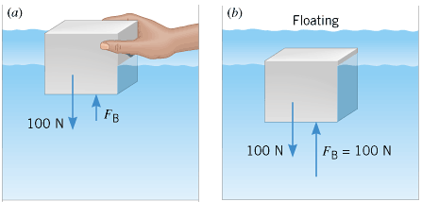
Floating Object
Buoyant Force = Object’s Weight = Weight of the displaced fluid

Slide 17
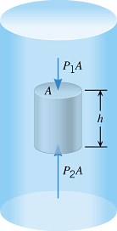
Derivation
Consider a cylinder of height h is being held under the surface of a liquid.
The fluid applies a downward force P₁A to the top face of the submerged cylinder and an upward force P₂A to the bottom face.

